Slide 1

Strategic Business Planning
Starting to Plan….
What are Important First Steps?

Slide 2
Getting Started: Readings
Developing a Business Plan
  “Building a Sustainable Business”
    Pages 87-102, Vision, Mission and Goals
    103-126, Strategic Planning
    Worksheets build on this book
Strategic Business Planning Fact Sheet
  Strategic Planning Steps
  Introduction to AgPlan
  Examples in AgPlan
Note: This fact sheet draws heavily from work by Penn State’s Alternative Agriculture Center and its work on business planning
Notes:
Assignments should be made prior to first evening of class
If possible, use intermediate producers to share their goals/mission statements or planning principles
Breakouts are used halfway through to build community and provide immediate feedback on the strong and weak points of mission statements

Slide 3
Getting Started:
Course Introduction
Building Capacity and Community in our Region
  Advisory Board and Farmer Introductions
Strategic Planning Steps
  Quick overview of Business Plan
  Goals and Objectives
  SWOT Analysis
Breakout Groups
  Share Mission Statements and/or Goals
Notes:
Assignments should be made prior to first evening of class
If possible, use intermediate producers to share their goals/mission statements or planning principles
Breakouts are used halfway through to build community and provide immediate feedback on the strong and weak points of mission statements

Slide 4
Overview of a Business Plan
A business plan can follow a variety of formats, but common elements include:
  Executive summary and background info
  Mission statement, goals, and objectives
  Organizational matters (tax and legal issues)
  Marketing plan (target customers, prices)
  Financial plan and detailed projections
  For food production, detailed production plans, including a calendar of tasks and cash flows, may also be essential to a good plan

Slide 5
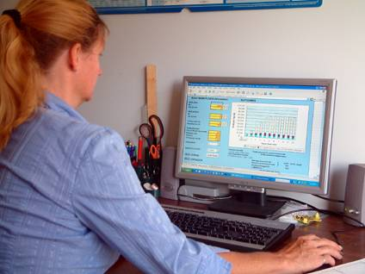
Why spend so much time on planning?
70+ percent of new businesses fail in the first year.
Business failures are most often due to
  Inadequate planning
  Under capitalization
  Lacking needed management skills as part of their “team”
Notes:
You may have seen a sign that says: “People don’t plan to fail, they fail to plan.” There’s no doubt that adequate advance planning is essential for small business successes. The failure rate for new businesses is about 70 to 80 percent in the first year. Only about half of those who survive the first year will remain in business the next five years. Do your planning and avoid being a statistic!

Slide 6
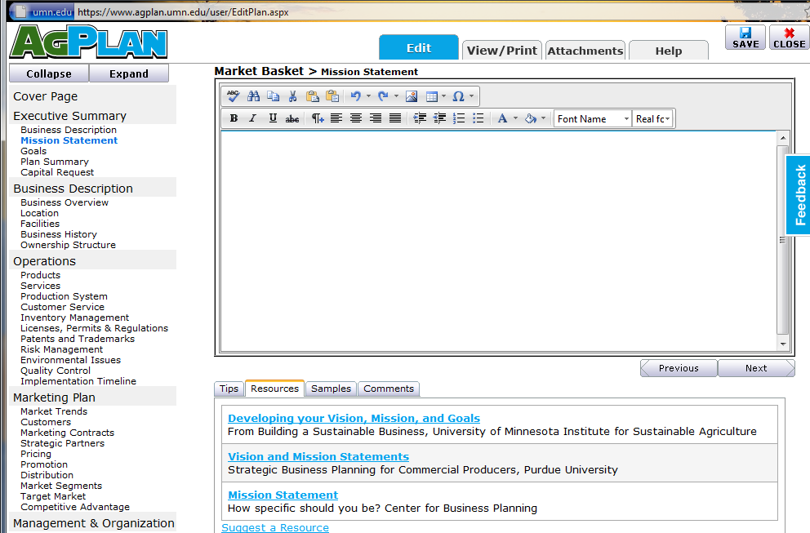
Resource for Plans: AgPlan
Notes:
AgPlan is not only a good resource to use for organizing and collating your plans throughout this program (and as you continue planning). It also shows you all potential elements of a good plan, resources and examples you can draw from and different ways to access your information (viewing, printing, adding attachments).
It is unlikely you will complete all these planning elements in this short program, but your goal should be to make significant progress, and revisit this in the future to make it more complete and refined.

Slide 7
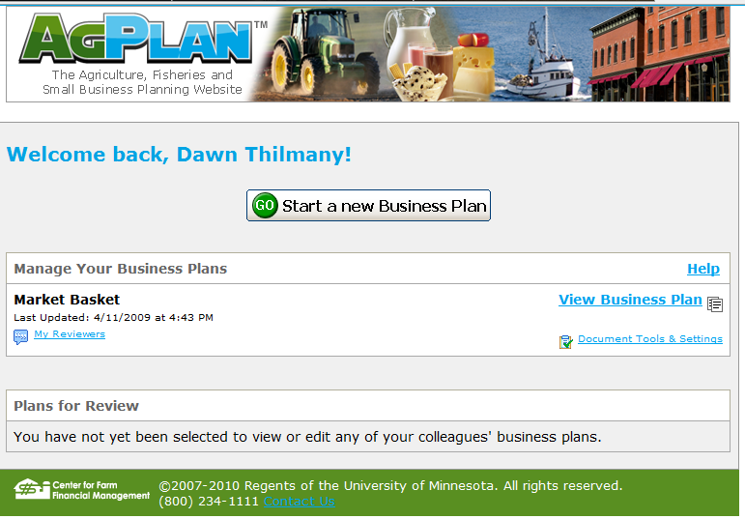
Resource for Plans: AgPlan
Resources: https://www.agplan.umn.edu/
Notes:
Walk the participants through the structure of registering, making a business plan, and how you can invite reviewers (including class coordinators)

Slide 8
What is Strategic Management?
Strategic management is all about anticipating, driving, and capitalizing on change:
  Driving: shaping the future (Goals)
  Anticipating: seeing the future (SWOT)
Notes:
SWOT is all assessment and something we’ll focus on..and have you tackle for your business
Goals should be justified by SWOT, and begin to give you direction as a manager
TOWS (SWOT backwards) combines these elements…how you use Strengths to capitalize on opportunties (or mitigate threats)….but this may be farther than you are ready to go with your plan at this point…

Slide 9
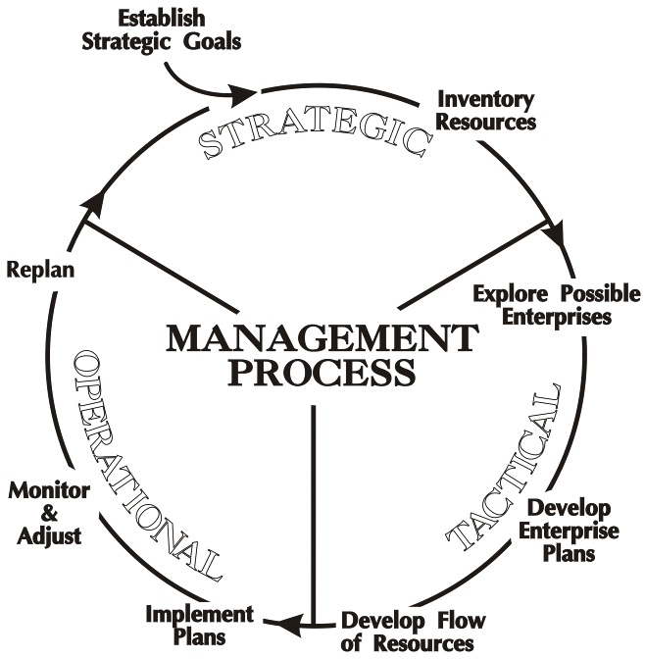
Notes:
STRATEGIC = Determine your business goals & what resources you have: Land, Labour, Capital, Management (personnel & skills, team members)
TACTICAL = what products can we produce; what can be produced best; how will our resource fit that, do we need to acquire some resources? (i.e., training, capital investment, part-time help, etc.)
OPERATIONAL = Let’s do it! But keep track of progress (management by exception) and make changes as needed to keep things on track.

Slide 10
Vision, Goals and Mission
  Dream a Future Vision
  Set and Prioritize Goals
  Develop a Mission Statement

Slide 11
Vision: What’s Important to You?
Values
  Small, family owned businesses may need to discuss the role of values
  Values are the standards, beliefs or qualities that you consider worth upholding or pursuing.
    They are not goals, but instead can be thought of as something that reflects your view on life or a judgment about what you find important.
  Your values will directly shape your business strategy and whole farm management choices.
Notes:
These values may be revisited in marketing (to connect with consumers) but are essential to all realms of the business, so are important to consider at this initial stage
Mission should reflect values and how they relate to external stakeholders (customers, lenders. community) and internal people (employees, family)

Slide 12
GOALS
Goals should be SMART:
  Specific (not vague or general)
  Measurable (quantitative not qualitative)
  Attainable (can be done)
  Reasonable (is not a huge “reach”)
  Timed (it will be done by when?)
Notes:
Goals (or objectives) should follow the acronym SMART, which stands for: Specific, Measurable, Attainable, Reasonable, and Timed.

Slide 13
Vision/Mission Statements
Statements that explain who we are
  Type of organization
  Products/services
  Needs we fill
Statements that explain our direction, our purpose, our reason for being
  What difference do we make?
Statements that explain what makes us unique
  Values
  People
  Combination of products and services
Notes:
Vision/Mission Statements:
*Part of the Leading Managerial Function (how we communicate and convey with one another our goals, perspectives and judgments)
*The mission and/vision statement acts like a rudder on a ship – it sets the direction for the firm and helps us to hold true to our course. The mission statements sets the strategic direction, guides us to the opportunity
The mission statement explains what we do, and how we got there. It describes what we do to reach our goals.
The vision statement discusses how we fit in the world.

Slide 14
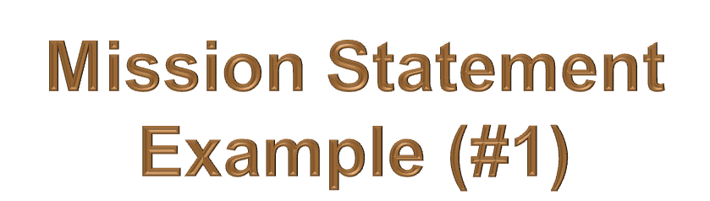


or the last century the Louthan family has established deep roots in the agriculture industry, and has developed a reputation for producing high quality Angus crossbred beef. Our family operation incorporates quality genetics to produce high grading, great yielding calves, which will gain weight quickly to harvest. We perform superior animal husbandry practices to ensure a healthy, high quality product that our customers in the cattle feeding industry can trust.
Notes:
Connects with those who want to support family heritage…eating quality addressed with breed…..what could this mission statement do better?

Slide 15
Mission Statement
Example (#2)
Herb Appeal is a retail greenhouse focusing on organic herbs but also providing different types of herbaceous plants and hard goods. We will promote the use of organic plants and materials in the environment. Quality organic plants and knowledge based customer service guarantee a good overall value to our customers.
Notes:
Another example….clear about its product and how you can buy….high service, but what other values?

Slide 16
Mission Statement
Example (#3)
We are committed to producing quality, all-natural, raw dairy products. By sharing livestock ownership, customers have an authentic opportunity to experience agriculture production from farm to table. This partnership creates a niche market providing unique, wholesome milk, beef, and compost. And because customers are part owners in our business, they are guaranteed high value food and resources before they’re even produced! We’re located on Colorado’s central front range, and your milk comes straight “from our cows to your family!”
Notes:
Explains how you get involved with this business, integrating some values….but should there be more since this is a big commitment and customers may want to know more??

Slide 17
SWOT Analysis
Competitors
Customers
Purpose to identify:
  Strengths
  Weaknesses
  Opportunities
  Threats
Firm
Internal
External
Market
Conditions
Notes:
Note: you do need to understand the “goods and bads” of your firm, but external forces are at least as important
If you don’t know whether something is internal or external, ask whether you control it…if not, it is external

Slide 18
Strengths and Weaknesses
(mostly internal)
Goal: objective assessment of your strengths and weaknesses to:
  identify, protect and deploy resources,
  understand capabilities and
  develop core competencies.
Notes:
These are all important elements of that competitive advantage we discussed

Slide 19
SWOT: Resources
Inputs into a firm’s production process such as capital equipment, skill of individual employees, patents, finance, and talented managers.
  Tangible Resources – Assets that can be seen and quantified
  Intangible Resources – Family commitment, networks, organizational culture, reputation,
By themselves resources do not create a strategic advantage for the firm
  Examples of misdirected resources?

Slide 20
SWOT: Capabilities
Consider marketing
  products/services that serve new market
Consider people
  Relationships/networks
Consider operations/facilities
  Cost management/efficiency
Consider finances
  Capital resources-ability to obtain credit

Slide 21
SWOT: Core Competencies
Core competencies must be distinctive.
  Capabilities that are done better than competitors
Identifying core competencies is key to development of sound strategy.
All this must be in the context of your vision for your business…..and the mission of why your business is needed….and should frame your goals…
Notes:
Using good at keeping thorough budgets and finances as an example of core competencies.
Valuable Capabilities
A unique capability to organize production and marketing records and facility with numbers.
Rare Capabilities
An ability to forecast production flows and market sales well.
Costly to Imitate Capabilities
Your past history with production in the region and sales with another farm at markets, gives you insights few have to estimate budgets
Non-substitutable capabilities
There are few public budgets available for others to use if they don’t keep their own records

Slide 22
Strengths and Weaknesses
(mostly internal)
Once you understand your resources, capabilities and core competencies:
Assess strengths and weakness:
  Relative to your competitors and
  What’s important to your customers.
Note: This is difficult to do well.
Notes:
These are all important elements of that competitive advantage we discussed

Slide 23
Opportunities and Threats
(mostly internal)
Goal: to improve your ability to scan, monitor, forecast and assess factors in the surrounding environment
Allowing you to better identify opportunities and threats to the businesses’ long-term profitability.

Slide 24
Industry Analysis:
The Five Forces
Threat of New Entrants
Bargaining
Power
of
Suppliers
Bargaining
Power
Of
Buyers
Industry Competitors
Rivalry Among
Existing Firms
Threat of Substitute Products
or Services

Slide 25

External Environment:
Drivers of Change
Globalization of Markets and Resources
Consumers’ Evolving Preferences
A More Demanding Food Industry
Government Interaction/Regulation
The Pivotal Role of Technology
Notes:
These were the five drivers of change.
How might these affect your operation? How will they influence goals?

Slide 26
Exercise:
Identifying Strengths and Weaknesses
Factor Analysis Summary
  List up to 3 strengths and 3 weaknesses in your firm’s internal environment
    Rate based on Priority
  Do the same for 3 threats and opportunities
    This becomes a very brief assessment of your current position, and may suggest directions….and linkages between strong and weak parts of your operation
Notes:
How will these help you form your goals? Reconsider your mission??

Slide 27
What Now??
Work on Mission, Goals and Objectives
  Breakout groups for 20 minutes after 15 minute break/work session
Share and brainstorm with peers …feedback to work on for next session

Slide 28

Thank You!

